Slide 1
CONCURRENCY CONTROL
IN
TRANASACTION MANAGEMENT

Slide 3
Dirty Read or temporary read problem
This problem occurs when one transaction updates a database item and then the transaction fails for some reason .The updated item is accessed by another transaction before it is changed back to its original value.

Slide 5
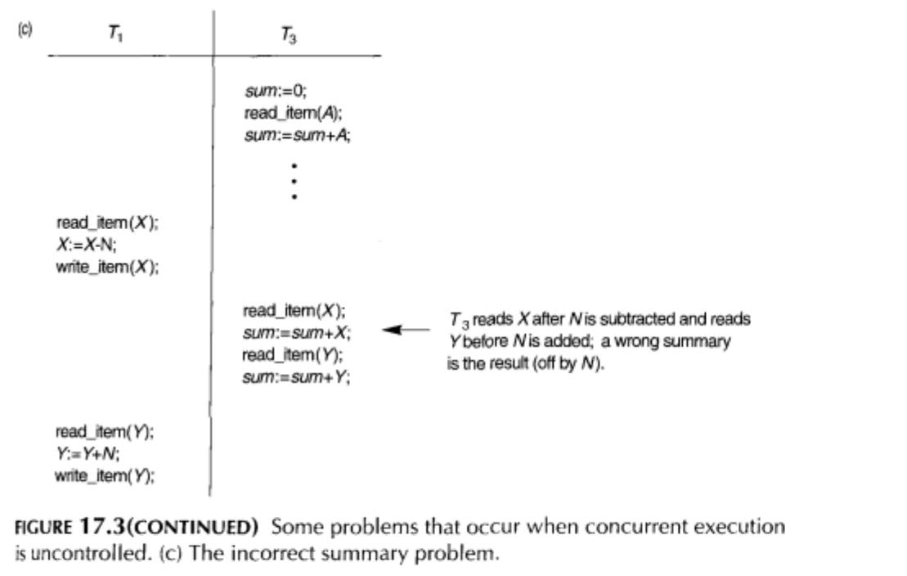
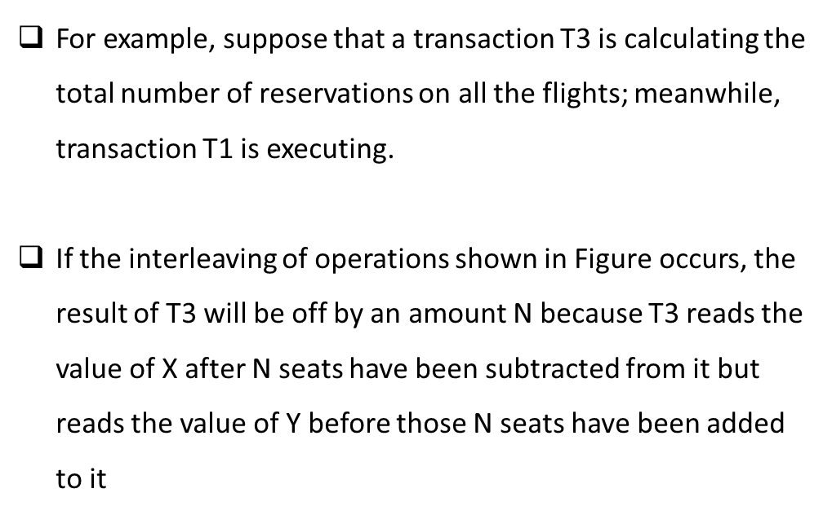
The Incorrect Summary Problem.
one transaction is calculating an aggregate summary function on a number of records while other transactions are updating some of these records, the aggregate function may calculate some values before they are updated
and others after they are updated.(Eg. Seeing different remaing available seats in train reservation by different users)

Slide 6
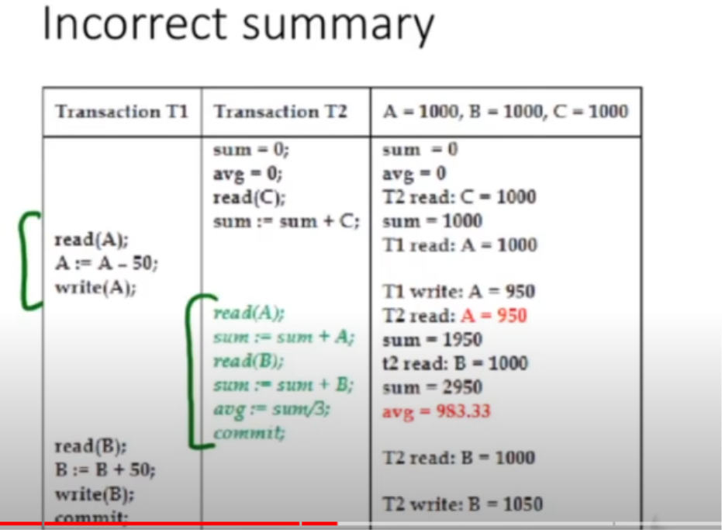
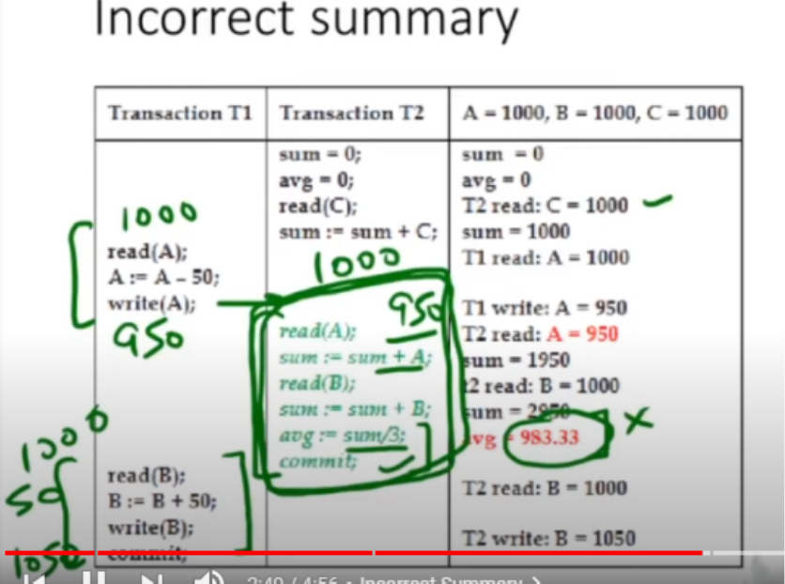

Slide 7
The lost update problem.
The Lost Update Problem. This problem occurs when two transactions that access the same database items have their operations interleaved in a way that makes the value of some database items incorrect.

Slide 8
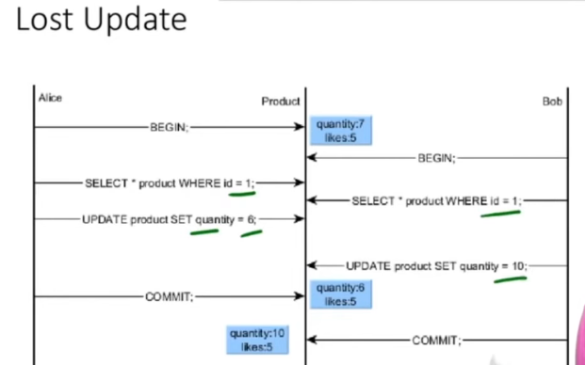

Slide 9
Unrepeatable read
A transaction T reads an item twice and the item is changed by another transaction T' between the two
reads. Hence, T receives different values for its two reads of the same item.
This may occur, for example, if during an airline reservation transaction, a customer is inquiring about
seat availability on several flights. When the customer decides on a particular flight, the transaction then reads the number of seats on that flight a second time before completing the reservation.

Slide 11
Phantom Read
A transaction TI may read a set of rows from a table, perhaps based on some condition specified in the SQL WHERE-clause. Now suppose that a transaction Tz inserts a new row that also satisfies the WHERE-clause condition used in TI , into the table used by TI' If TI is repeated, then TI will see a phantom, a row that previously did not exist.

Slide 12
CONCURRENCY CONTROL TECHNIQUES
Locks
Binary Locks
Shared/Exclusive locks
2 – Phase Locking protocol
Time-stamp Ordering protocol

Slide 13
1.LOCKS
Definition :A lock is a variable associated with a data item that describes the status of the item with respect to possible operations that can be applied to it.
Generally, there is one lock for each data item in the database.
Locks are used as a means of synchronizing the access by concurrent transactions to the database items.
Types of Locks
Binary locks
Shared/Exclusive locks

Slide 14
2. Binary Locks
A binary lock can have two states or values: locked and unlocked (or 1 and 0, for simplicity).
A distinct lock is associated with each database item X.
If the value of the lock on X is 1, item X cannot be accessed by a database operation that requests the item.
If the value of the lock on X is 0, the item can be accessed when requested.
current value (or state) of the lock associated with item X is LOCK(X).
Two operations, lock_item and unlock_item, are used with binary locking.

Slide 15
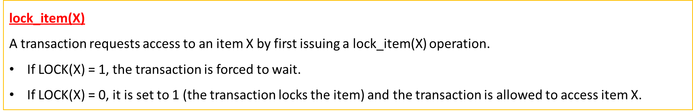
Lock_tem(X):
B:ifLOCK(X)=O (* item is unlocked *)
then LOCK(X)←1 (*lock the item*)
Else
begin
wait (until lock(X)=O and the lock manager wakes up the transaction);
Goto B
end;

Slide 16
unlock_item(X)
When the transaction is through using the item, it issues an un1ock_item(X) operation, which sets
LOCK(X) to 0 (unlocks the item) so that X may be accessed by other transactions
unlock_item (X):
LOCK (X)←O; (* unlock the item*)
If any transactions are waiting then wakeup one of the waiting transactions;
Hence, a binary lock enforces mutual exclusion on the data item.

Slide 17
Binary lock can be implemented easily using a binary valued variable, LOCK, associated with each data item X in the database.
Each lock can be a record with three fields: <data item name, LOCK, locking transaction> plus a queue for transactions that are waiting to access the item.
The system needs to maintain only these records for the items that are currently locked in a lock table.
Items not in the lock table are considered to be unlocked.
The DBMS lock manager subsystem keep track of and control access to locks.
If the simple binary locking scheme described here is used, every transaction must obey the following rules:
1. A transaction T must issue the operation lock_i tem(X) before any read_i tem(X) or write_item(X) operations are performed in T.
2. A transaction T must issue the operation unl ock_i tem(X) after all read_i tem(X) and wri te_i tem(X) operations are completed in T.
3. A transaction T will not issue a 1ock_i tem(X) operation if it already holds the lock on item X.
4. A transaction T will not issue an unl ock_i tern(X) operation unless it already holds the lock on item X.

Slide 18
3. Shared/Exclusive (or Read/Write) Locks.
Binary locking scheme is too restrictive for database items, because at most one transaction can hold a lock on a
given item. We should allow several transactions to access the same item X if they all access X for reading purposes only.
However, if a transaction is to write an item X, it must have exclusive access to X.
For this purpose, a different type of lock called a multiple mode lock is used.
In this scheme-called shared/exclusive or read/write locks-there
are three locking operations: read_lock(X), write_lock(X), and unlock(X).
For item X, LOCK(X), now has three possible states: "read-locked," "write locked," or "unlocked."
A read-locked item is also called share-locked, because other transactions are allowed to read the item.
A write-locked item is called exclusive-locked, because a single transaction exclusively holds the lock on the item.

Slide 19
Each record in the lock table will have four fields: <data item name, LOCK, no_of_reads, locking transactions>
If LOCK(X)=write-locked, the value of locking transactions is a single transaction that holds the exclusive (write) lock on X.
If LOCK(X)=read-locked, the value of locking transactions is a list of one or more transactions that hold the shared (read) lock on X.
The three operations read_lock(X), write_lock(X), and unlock(X)

Slide 22
Conversion of Locks
Sometimes it is desirable to relax conditions 4 and 5 to allow lock conversion; that is, a transaction that already holds a lock on item X is allowed under certain conditions to convert the lock from one locked state to another.
It is possible for a transaction T to issue a read_lock(X) and then later on to upgrade the lock by issuing a
write_l ock(X) operation. If T is the only transaction holding a read lock on X at the time it issues the write_lock(X) operation, the lock can be upgraded otherwise, the transaction must wait.
It is also possible for a transaction T to issue a wri te_l ock(X) and then later on to downgrade the lock by issuing a read_lock(X) operation.
The descriptions of the read_lock(X) and wri te_l ock(X) operations must be changed appropriately.

Slide 23
Problems of Locks
Using binary locks or read/write locks in transactions, does not guarantee serializability of schedules on its own.
This is because in Figure a the items Yin T1and X in T 2 were unlocked too early
To guarantee serializability, we must properly position the locking and unlocking operations in every transaction.
Transactions that do not obey two-phase locking. (a) Two transactions T1 and T2. (b) Results of possible serial schedules of T1 and T2. (c) A nonserializable schedule S that uses locks

Slide 25
Irrecoverable Schedule
(Dirty read problem exists)
Deadlock exists
Infinite waiting of T1 and T2 on locks
Starvation :
T2 locks in S mode.
T1 wants lock in X mode and waits
T3 locks in S mode(granted)
T2 unlocks and T3 uses but T1 waits
T4 locks in S mode(granted)
T3 unlocks but T1 waits as T4 locked it
………
T1 waits indefinitely(Starvation)

Slide 26
4. Two-Phase locking (2PL)protocol
A transaction is said to follow the two-phase locking protocol if all locking operations (read_lock, write_lock) precede the first unlock operation in the transaction.
Such a transaction can be divided into two phases:
An expanding or growing (first) phase
New locks on items can be acquired but none can be released;
A shrinking (second) phase
locks can be released but no new locks can be acquired.

Slide 27
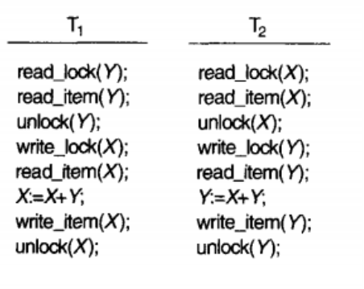


Slide 28
It can be proved that, if every transaction in a schedule follows the two-phase locking protocol, the schedule is guaranteed to be serializable.
Two-phase locking may reduce the amount of concurrency that can occur in a schedule.
This is because a transaction T may not be able to release an item X after it has finished using it if T must lock an item Y later on. Or ,T must lock the additional item Y before it needs it so that it can release X
Hence, X must remain locked by T until all items that the transaction needs to read or write have been locked; only then can X be released by T
Meanwhile, another transaction seeking to access X may be forced to wait, even though T is done with X;
Conversely, if Y is locked earlier than it is needed, another transaction seeking to access Y is forced to wait even though T is not using Y yet.

Slide 29
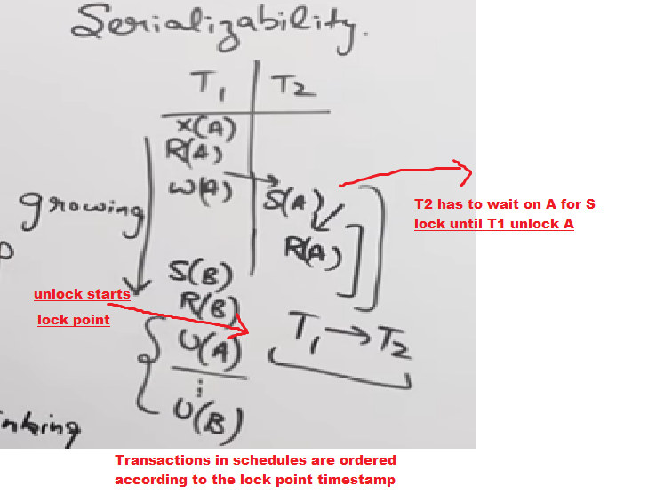
Lock point: A point where a transaction acquire last lock or where it first starts un locking

Slide 30
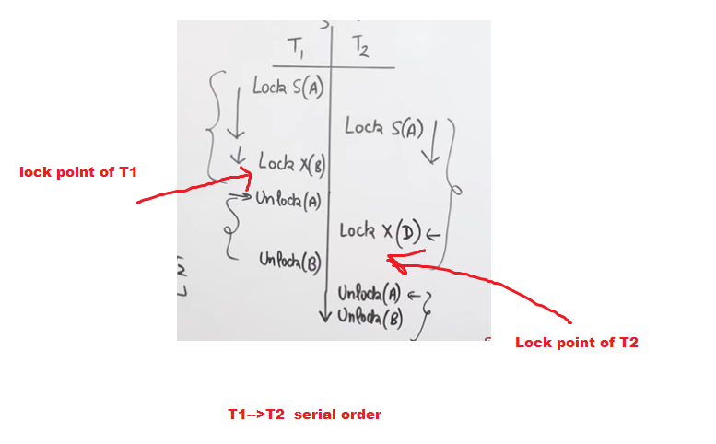
Although the two-phase locking protocol guarantees serializabiliry (that is, every schedule that is permitted is serializable), it does not permit all possible serializable schedules (that is, some serializable schedules will be prohibited by the protocol)

Slide 31
Drawbacks of 2PL

Slide 32
Irrecoverable Schedule
Cascading Rollback

Slide 33
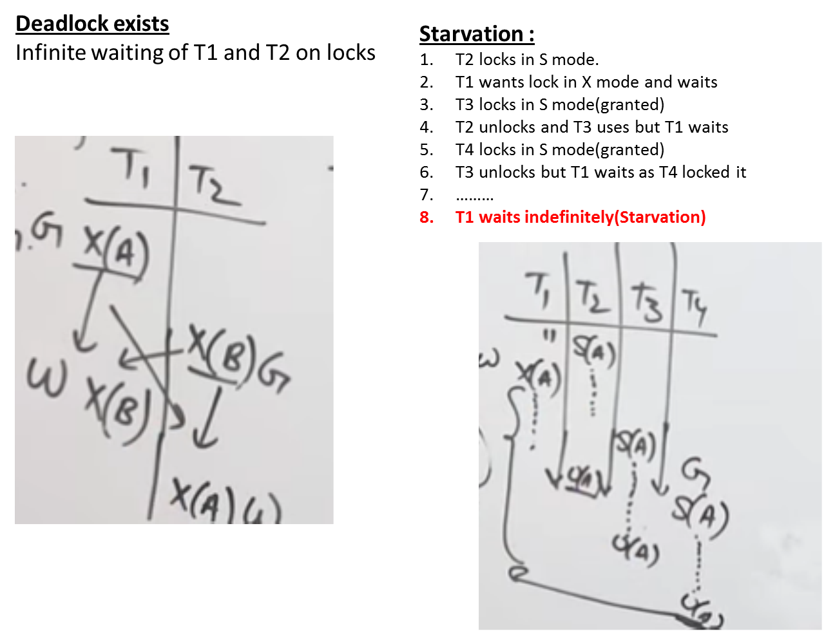

Slide 34
Basic, Conservative, Strict, and Rigorous Two-Phase Locking
Basic 2PL The technique just described is known as basic 2pL
Conservative 2PL A transaction lock all the items it accesses before the transaction begins execution, by predeclaring its readset and write-set.
read-set of a transaction is the set of all items that the transaction reads.
write-set is the set of all items that it writes.
If any of the predeclared items needed cannot be locked, the transaction does not lock any item; instead, it waits until all the items are available for locking.
Conservative 2PL is a deadlock-free protocol

Slide 35
Strict 2PL
guarantees strict schedules (in which transactions can neither read nor write an item X until the last transaction that wrote X has committed (or aborted).
A transaction T does not release any of its exclusive (write) locks until after it commits or aborts.
Hence, no other transaction can read or write an item that is written by T unless T has committed, leading to a strict schedule for recoverability.
Strict 2PL is not deadlock-free.
It is produces strict, Recoverable, cascade less schedule

Slide 36
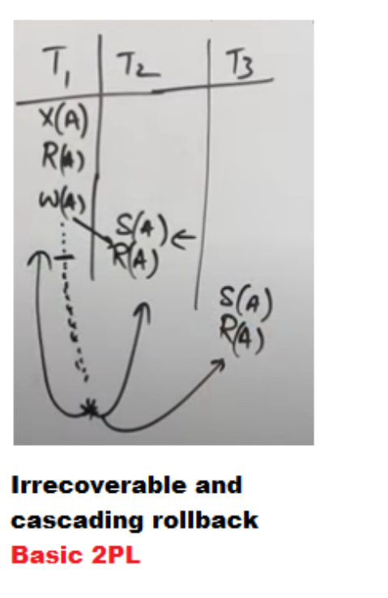

Slide 37
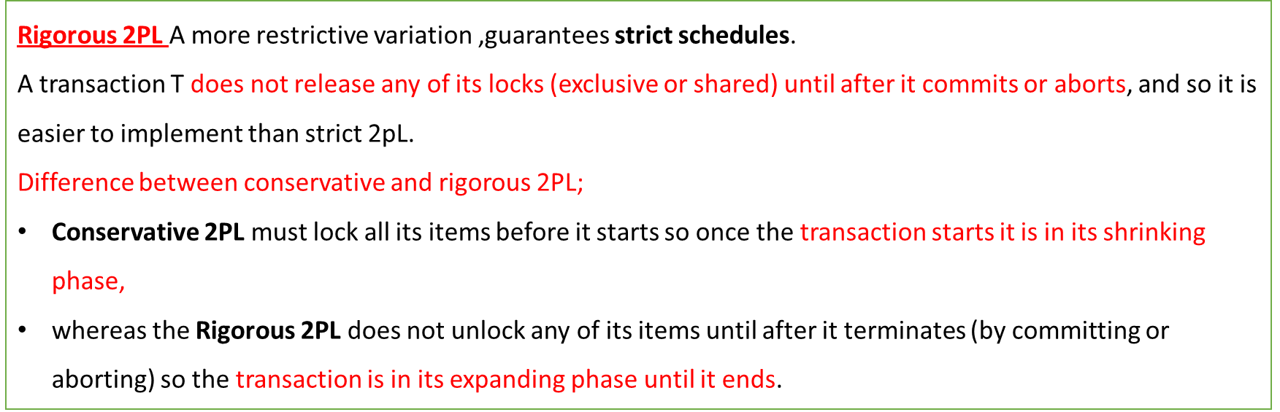

Slide 38
Deadlock and Starvation
Deadlock occurs when each transaction T in a set of two or more transactions is waiting for some item that is locked by some other transaction T' in the set.
Hence, each transaction in the set is on a waiting queue, waiting for one of the other transactions in the set to release the lock on an item.
T I' is on the waiting queue for X, which is locked by T2" while T2' is on the waiting queue for Y, which is locked by TI '
Meanwhile, neither T 1' nor T2' nor any other transaction can access items X and Y.

Slide 39
Deadlock Prevention Protocols
Protocol-1
One deadlock prevention protocol, which is used in conservative two-phase locking, requires that every transaction lock all the items it needs before it starts (which is generally not a practical assumption)-
If any of the items cannot be obtained, none of the items are locked. Rather, the transaction waits and then
tries again to lock all the items it needs.
Protocol-2
It limits concurrency, involves ordering all the items in the database and making sure that a transaction that needs several items will lock them according to that order.
This requires that the programmer (or the system) be aware of the chosen order of the items, (not practical)

Slide 40
Other protocols
Deals with : What to do with a transaction involved in a possible deadlock situation?
Should it be blocked and made to wait?
or should it be aborted,
or should the transaction preempt and abort another transaction?
These techniques use the concept of transaction timestamp TS(T),a unique identifier assigned to each transaction when it starts.
if transaction T1 starts before transaction T2, then TS(T1) < TS(T2).
older transaction has the smaller timestamp value.

Slide 41
Suppose that transaction T1 tries to lock an item X but is not able to because X is locked by some other transaction T2 with a conflicting lock.
Wait-die:
If TS(T1) < TS (T2 ) , then (T1 older than T2 )
T1 is allowed to wait;
else (T1 younger than T2)
abort T1 (T1 dies) and restart it later with the same timestamp.
End
In wait-die, an older transaction is allowed to wait on a younger transaction, whereas a younger transaction requesting an item held by an older transaction is aborted and restarted.

Slide 42
Wound-wait:
If TS(T1) < TS(T2 ) , then (T1older than T2 )
abort T2 (T1 wounds T2 ) and restart it later with the same timestamp;
else (T1 younger than T2)
T1 is allowed to wait.
End
The wound-wait approach does the opposite: A younger transaction is allowed to wait on an older one, whereas an older transaction requesting an item held by a younger transaction preempts the younger transaction by aborting it.

Slide 43
Both schemes end up aborting the younger of the two transactions that may be involved in a deadlock.
It can be shown that these two techniques are deadlock-free, since in wait-die, transactions only wait on younger transactions so no cycle is created.
Similarly, in wound-wait, transactions only wait on older transactions so no cycle is created.
However, both techniques may cause some transactions to be aborted and restarted needlessly, even though those transactions may never actually cause deadlock

